Slide 1
Pre-consultation workshop on evaluation, quality standards and methodology
ARACIS
21 February 2019

Slide 2
Main structure of the day 9h45-14 h
Short presentations / discussions
Introduction
Rationale, principles and approach
Evaluation frameworks
Scoring and thresholds
Evaluation methodology for internal / external

Slide 3
Objectives, principles and approach to quality
ARACIS
21 February 2019

Slide 4
What are the main objectives of the project?
Fully aligning with European standards
Improving confidence in the QA system
Making QA system useful for quality enhancement
Employability
Comparability
Meeting expectations of stakeholders
Updating the evaluation framework
Improving the methodology

Slide 5
What are the specific objectives?
Modernising (not revamping) the national QA system
Streamlining the evaluation frameworks
Improving the consistency of the evaluation
Combine quality assessment with quality improvement

Slide 6
I - Modernising the national QA system
Embedding European standards for quality
Brief recall of ESG
Other source of inspiration (ECTS guidelines)
Including ground-breaking issues such as:
Distance learning
Project based learning / Work placement
Mobility / Joint programmes
Student with disabilities
Innovate for universities advanced in QA
Quality audit

Slide 7

Main principles for QA in Europe
HEIs have primary responsibility for the quality of their provision and its assurance
EQA shall respond to the diversity of higher education systems, institutions, programmes and students
QA supports the development of a quality culture
QA takes into account the needs and expectations of students, all other stakeholders and society → strong importance for stakeholder involvement!
___
QA should combine the purposes of accountability and enhancement
Safeguard the independence of QA agencies
Notes:
That the university itself has the primary responsibility for the quality of its own provisions/studies seems obvious. Nevertheless it is stated in the various laws regulating higher education across Europe.
EQA, the external quality assurance in higher education, (preformed by agencies), even though it is based upon ESG, shall always respond to the diversity in the country and in the sector
QA and quality work in general is not to be done by quality professionals alone but by involving all parties: the students, the teachers, the leaders on all levels. A quality culture does not come by itself, but evolves around structures like a quality policy, a quality system and a well functioning quality work
… … that takes into account the needs, experience and expectations of student and main stakeholders.
___
The statement that QA should combine the purposes of accountability and enhancement is not an explicitly stated principle. However, it is a statement that is penetrating all modern quality work.
Nor Independence of QA agencies is a principle. It is one of the standards. Even so I always point on independence from the beginning: The QA agency should not be a part of, or under too strong influence of the ministry

Slide 8

Part 1: Institutions’ internal quality assurance
1.1 Policy for quality assurance
1.2 Design and approval of programmes
1.3 Student-centered learning, teaching and assessment
1.4 Student admission, progression, recognition and certification
1.5 Teaching staff
1.6 Learning resources and support
1.7 Information management
1.8 Public information (2.6 on reporting)
1.9 On-going monitoring and periodic review of programmes
1.10 Cyclical external quality assurance
Notes:
Are you familiar with the ESG?
This picture shows the standards to which European Higher Education Institutions have to comply.
The standards given in the document are obligatory, the guidelines are what they claim to be: guidelines.
Even if you are not a part of the EHEA, I recommend you both to read and try to implement these standards. To me at least, they make up a useful tool to quality assurance.
Which standard do you think will be the most challenging?

Slide 9
Trends in European QA
Possible move to “softer” approaches (fitness-for-purpose), especially in well-established QA systems: from programme to institutional approaches; risk-based methods; more flexible methods or methods based more on institutional priorities
Going beyond minimum standards and find ways to measure and reward excellence
Greater importance given to the usefulness and readability of reports (competing with international or national rankings as information source?)
External accountability of agencies
Wider involvement of stakeholders accepted and required
Notes:
Read the text
Involving stakeholders: Again and again: involve students!

Slide 10
Some challenges in European QA
student involvement
publication of reports
collaborative relationship with HEIs
QA of alternative delivery modes (e-learning, lifelong learning…)
use of international reviewers
Notes:
Resources, restrictions
Again: Institutions have to accept and appreciate student involvement
ESG requires publishing of full reports, both the once with a positive conclusion and those who are negative
The agencies have to keep an arm length distance to both the Ministry and the institutions. However the Agency’s external QA on institutions should be build on purposeful communication, involving institutions, and other stakeholders in designing the methods and criteria
Internationalisation read the text

Slide 11
II - Streamlining the evaluation frameworks
Bachelor / Master / Doctoral schools:
one-size fits all but with nuances
Learning outcomes are key => QA
Consistency with existing quality standards
from disciplines and regulated professions
Clarification between standards/criteria/PI
Overarching evaluation framework (inclusiveness)
Fit for all
student-centred

Slide 12
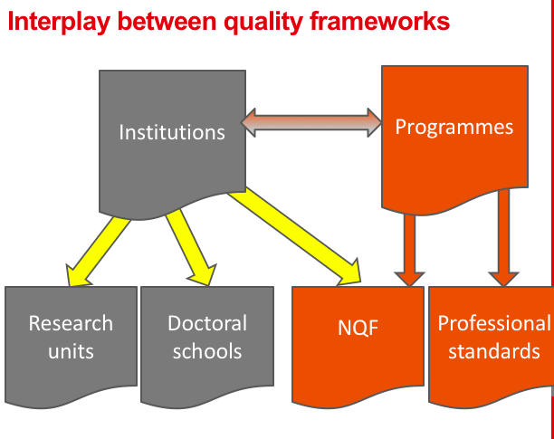
Inclusiveness of QA framework

Slide 13
III - Improving the consistency of the evaluation reports
Sign of robustness and legitimacy for QA Agency
Expectations from HEIs
Emphasis on the judgement of quality;
not only depicting facts but formulating analysis on evidence
How can we help?
Guiding the external experts
Come to an agreement on quality standards and criteria

Slide 14
IV - Combine quality assessment with quality improvement
One tool, 2 objectives
Institutional / programme accreditation
Relates to each other, but purpose is different.
Disconnect conditions to operate from quality issues
Role of Ministry / role of QA and HEIs

Slide 15

Where do we stand?
Regular meetings with ARACIS
Punctual meetings with Higher education institutions
Desk review
Comparative analysis
Pre-consultation
Methodology + QA Audit
National event
National consultation
Piloting
Nov-January 2019
November 2019
Nov-February 2019
Nov-February 2019
February 2019
March –May 2019
End May 2019
Early June 2019
Summer / September 2019

Slide 16
Discussion points

Slide 17
2. Quality standards and Evaluation frameworks
ARACIS
21 February 2019

Slide 18


Evaluation framework
3 areas (by law)
Criteria
Standard
Performance indicators
Min / Ref
Source/Evidence
Notes:
level of requirements and conditions by which quality is assessed or that must be achieved by higher education institutions and their programs for accreditation or certification. In order to correctly judge whether a particular quality standard is met or not, a standard must be formulated clearly and explicitly and linked to specific criteria, which can be divided into (more operational) indicators/guidelines.

Slide 19
Evaluation framework as presented today
3 areas (by law)
6 domains
Standard
Criteria
Source/Evidence
Notes:
level of requirements and conditions by which quality is assessed or that must be achieved by higher education institutions and their programs for accreditation or certification. In order to correctly judge whether a particular quality standard is met or not, a standard must be formulated clearly and explicitly and linked to specific criteria, which can be divided into (more operational) indicators/guidelines.

Slide 20
Main structure
6 Domains
Strategy and governance
Quality assurance system
The Curriculum
Teaching, Learning and Assessment
Research support
Students and their Support
Notes:
6 domains for quality are suggested to reflect the key missions and quality expectations of Romanian higher education institutions, irrespective of their category:

Slide 21
Definitions
Domain | Domains are the major areas of the quality assurance system that are subject to evaluation.
Standard | Standards indicate the expected level of requirements and conditions by which quality is assessed or that must be achieved by higher education institutions and their programs for accreditation or certification. In order to correctly judge whether a particular quality standard is met or not, a standard must be formulated clearly and explicitly and linked to specific criteria, which can be divided into (more operational) indicators/guidelines.
Criteria/ guidelines (as per ESG wording) | Criteria are control/guiding points/lines that determine the realisation/fulfilment of the standards. The criteria detail the requirements and conditions to be met in order to reach the standard, and provide the quantitative and qualitative basis on which an evaluative conclusion is drawn.
Evidence | Evidence is the data used to determine the achievement of the standards though the criteria Evidence can be either qualitative or quantitative. They must be collected regularly. To do this, the HEI is encouraged to provide empirical data, for example by developing a statistical system.

Slide 22
Strategy and governance (domain A)
Standard 1 : The institution’s vision and strategic plan are in alignment with its mission. The institution has adequate policies, processes, procedures and instruments to realize its mission and implement its strategic plans.
Criteria:
The institution has set and published a mission statement.
The institution’s strategies and policies comply with the mission statement.
The strategy of the Institution is implementable and in consistency with the national development priorities.
The institution is committed into the evaluation of quality, integrity, and effectiveness of its academic programs.
The institution ensures the consistency of institutional and faculty/department strategies with a view to preventing conflicts.
The institution assures equal opportunities for development and improvement between different units (faculty, departements, programmes).
The institution has and ensures the establishment of mechanisms that ensure the implementation of the charter of values and its proper functioning.
The institution has an action plan, based on priorities and broken down into monitoring indicators.
Etc.
Domain
To be expected, non negotiable
Examples, to be amended, added or removed

Slide 23


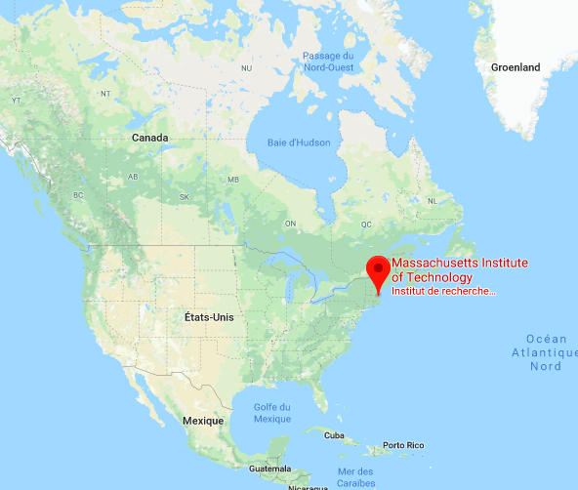

A quality framework for all institutions
Notes:
728 M USD. / 3 M €.

Slide 24
A quality framework for all institutions
The university has developed a research strategy in line with its mission
Number of PhD Student
Number of publications in Nature

Slide 25
A quality framework for all institutions
There is a research strategy and programming of research activities.
The MIT’s vision and strategy of the research have been elaborated with global top notch companies like Exxon and Google. Our priorities fit in with the 3 major domains: cancer, energy and climate change. Every year, Nobel prize winners assess then quality of our research products against criteria available here.

Slide 26
A quality framework for all institutions
There is a research strategy and programming of research activities.
The University’ s vision is being designed, focusing on local needs of SME’s of the region and addressing economical and ecological challenges of the Mediterranean sea.
The University envisages to set up a group of regional / South European experts to scrutinize the relevance and efficiency of its research activities.

Slide 27
Interplay institutional / programme accreditation

Slide 28
For programmes
Domain | Standards
Academic / Professional standards | Designed already by experts. Associated to National qualification framework (?) Will remain.
Strategy and governance Quality assurance system The Curriculum Teaching, Learning and Assessment Research support Students and their Support | New, and valid for any kind of programme. Related to the institutional quality standards

Slide 29
For programmes
Domain | Quality standards
Strategy and governance | The institution’s vision and strategic plan are in alignment with its mission. The institution has adequate policies, processes, procedures and instruments to realize its mission and implement its strategic plans. The programme’s objectives are aligned with the strategy of the university and of the Faculty. There are processes in place to make sure the programme can be implemented according to the strategies of the university and of the faculty. Personnel and students and other stakeholders are involved in the design and implementation of the institution’s strategy. The programmes are designed a regularly updated with the contribution of academics, students, employers or other external stakeholders.

Slide 30
Discussion points

Slide 31
Which structure? and then…
Adapting the quality framework to Romanian distinctive features
Domain | Standards | Relevance for Romanian HE system Compliance with the law Keep / Delete / Amend / Add
Strategy and governance | The institution’s vision and strategic plan are in alignment with its mission. The institution has adequate policies, processes, procedures and instruments to realize its mission and implement its strategic plans. Personnel and students and other stakeholders are involved in the design and implementation of the institution’s strategy. The institution contributes to the social, economic and cultural development of the territory on which it is located and at the national level. There is a clear and transparent division of responsibilities, duties and authorities among the governing/leading authorities and decision making bodies, personnel (academic and non-academic staff) and according to the expected qualifications. Students are involved in the administrative and decision-making processes and are incentivized to engage in the institution’s strategy and management. Institution pursues an open strategy of collaboration and partnership at a regional, national and international level. | Collaborative work with QA experts and ARACIS

Slide 32
Ensuring consistency and alignment with programme quality framework
Domain | Institutional standards | Programme standards Focus on learning outcomes Alignment with professional standards Alignment with NQF
Strategy and governance | The institution’s vision and strategic plan are in alignment with its mission. The institution has adequate policies, processes, procedures and instruments to realize its mission and implement its strategic plans. Personnel and students and other stakeholders are involved in the design and implementation of the institution’s strategy. The institution contributes to the social, economic and cultural development of the territory on which it is located and at the national level. There is a clear and transparent division of responsibilities, duties and authorities among the governing/leading authorities and decision making bodies, personnel (academic and non-academic staff) and according to the expected qualifications. Students are involved in the administrative and decision-making processes and are incentivized to engage in the institution’s strategy and management. Institution pursues an open strategy of collaboration and partnership at a regional, national and international level. | At level of Master programmes and Master domains: ARACIS has already developed a methodology that should be included in the new methodology. To be reflected in the umbrella methodology. Collaborative work with QA experts and ARACIS on a proposal by WB

Slide 33
Discussion points

Slide 34
4. Scoring and thresholds
ARACIS
21 February 2019

Slide 35
How to assess quality?
The objectives of QA assessment are twofold
Help the institutions improve their capacity;
Assess the attainment of the quality expectations

Slide 36
How to assess quality?
Existing: Minimum / Reference Performance indicator
A clear description of the expectation for each standard
Intensity of achievement (from little to sustainable)
Key standards among the range of standards
For instance, in Teaching : the pedagogical cooperation is instrumental to the consistency of the programme
In QA : setting a quality assurance unit is indispensable

Slide 37
About quality thresholds
What is the average level?
A national expectation?
A reasonable achievement according to the existing capacities of the Romanian HEIs
A commonly met achievement met by European HEIs?

Slide 38
Discussion points

Slide 39
4. Methodology
ARACIS
21 February 2019

Slide 40
Discussion points

Slide 41
Annexe
Alternative scope of quality framework

Slide 42
Extended domains
The 6 domains encompass all missions of higher education. However, ARACIS might want to pay more emphasis on some domain and disaggregate the 6 domains into others, e.g:
Strategy and vision
Governance and management
Human resources
Financial resources
Infrastructures and facilities
Student recruitment, admission, certification
Programme monitoring
Teaching, learning and assessment
Research, innovation, and 3rd mission
Community engagement
Partnerships and mobility
Communication

Slide 43
Dynamics
Conditions
Conditions
processus centraux de l’enseignement
Core process
For programmes
facteurs dynamisants
Pedagogical Innovation
Cooperation international
processus centraux de la recherche
Citieznship Enterpreneurship
Core process for student
Core process
For research
Conditions

Slide 44
Dynamic domains
Conditions to operate
Strategy and governance
Human resources and logistics
Communication
Quality assurance
Core process for training
Programme design
Programme monitoring (from implementation to updating)
Student assessment
Core process for research
Strategy and policy
Organisation and support
Evaluation of research
Interplay research-training
Core process for students
Support to success and improvement
Student life and engagement
Equality
Socioeconomic insertion
Quality levers, e.g:
Internationalisation
Entrepreneurship
Citizenship
Pedagogic innovation

